Slide 1

Business Analytics Capstone Framework for Strategy
Chotchuang Chotnapalai
2 August 2025

Slide 2
Problem Statement

Slide 3
Problem Statement– Impact of Adblockers on GYF
Adblockers are disrupting GYF’s advertising ecosystem:
As of Q2 2023, there are 912 million internet users worldwide who use ad blockers. Of these, 496 million users are on mobile and 416 million are on desktop
About 31 to 32 percent of all internet users aged 16 to 64 use ad blockers
Publishers are projected to lose approximately 54 billion US dollars in 2024 due to ad blocking from total 8% of global digital ad spend.
Usage peaks among users aged 25 to 34 and among tech-savvy males at 36.9 percent
Ad blockers are intrusive ads at 62 percent, annoying ad formats at 54 percent, and privacy concerns at 40 percent
At least 6.7 percent of the top five thousand websites are now using anti-adblock detection methods
User behavior insights:
Users cite reasons such as: intrusive ads, privacy concerns, faster browsing, and better user experience.
High adblocker usage among tech-savvy, younger demographics and desktop users.
In some regions, adblocker adoption is rising faster than global average.
Organizational impact:
Potential loss of advertising revenue with multi-millions at risk per year.
Challenges in delivering promised reach to ad customers.
Increased pressure to innovate ad formats and measurement techniques.
Operational complexity in identifying blocked impressions and adapting reporting.
Strategic implications:
If unaddressed, ad blockers may erode GYF’s value proposition to both advertisers and users.
Need for data-driven solutions to understand, quantify, and address the problem.

Slide 4
Problem Statement– Application Exercise 1 – Research Methods and Tools
Types of Research to Employ
1. Exploratory Research
To identify root causes and scope of the adblocker issue.
Often uses qualitative methods such as focus groups and in-depth interviews
Question: “Why are more users using adblockers on GYF?”
2. Descriptive Research
To quantify and profile affected users/advertisers.
Relies on surveys, data analysis, and large-scale observation
Question: “What % of impressions are blocked? Who are the adblocker users?”
3. Causal Research
To test the impact of interventions or new strategies.
Question: “Does offering incentives to whitelist GYF increase ad viewability?”
Research Tools
Focus Groups: Qualitative insight from both advertisers and end users.
Surveys (traditional & mobile): Large-scale data collection.
Online Communities (MROCs): Ongoing discussions and insights.
Customer Self-Reporting: In-app/on-site pop-ups.
Social Media & Mobile Analytics: Track trends and measure engagement.
A/B Testing: Test new solutions (e.g., new ad formats, anti-adblocker messages).
Media Planning Firms & Third-party Data: Benchmarking and validation.

Slide 5
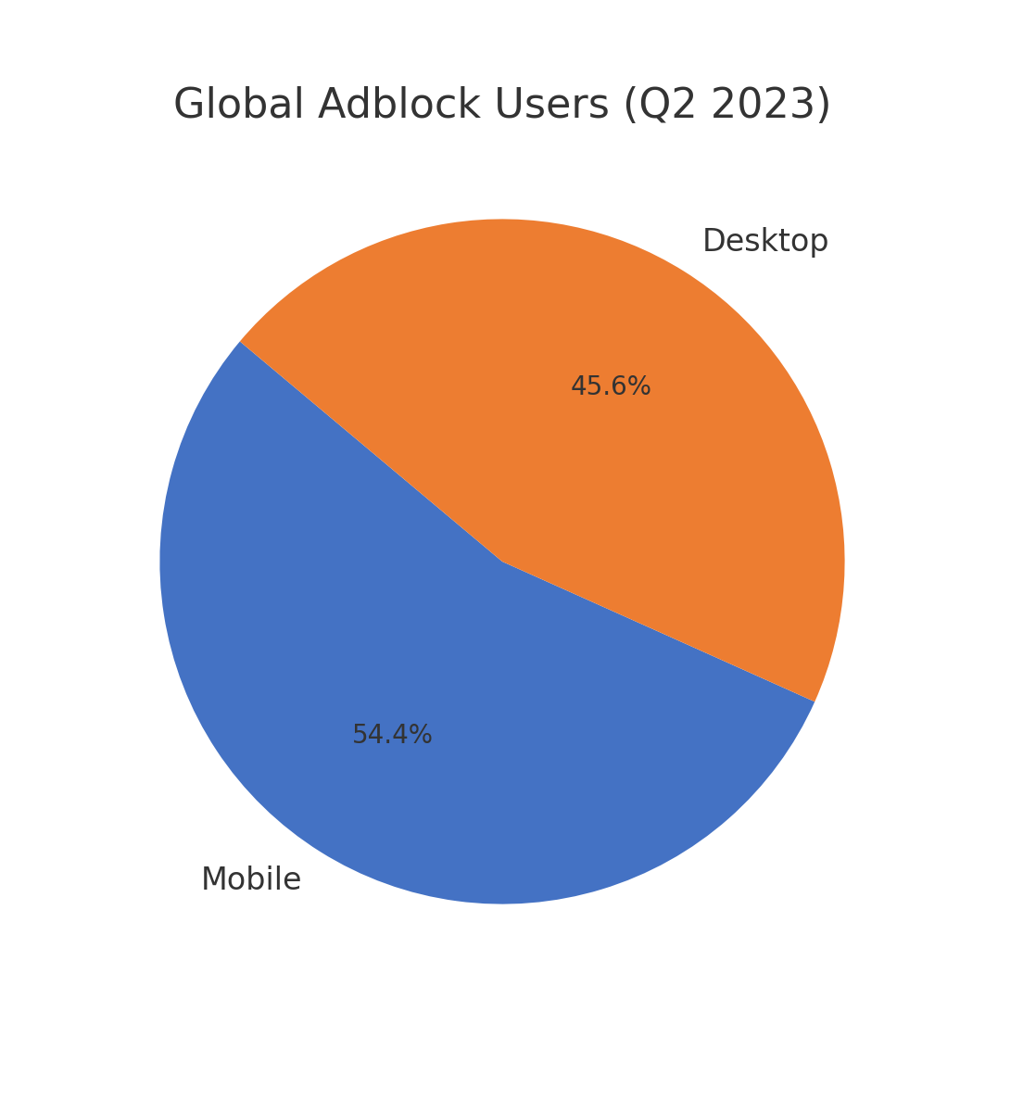
Problem Statement– Application Exercise 1 – Research Methods and Tools
Metric | Value
Global adblock users | 912 million (Q2 2023)
Mobile adblock users | 496 million (54.4%)
Desktop adblock users | 416 million (45.6%)
% of internet users (16–64) using ad blocker | ~31–32%
Estimated publisher revenue loss | US $54 billion (2024)
% of global digital ad spend lost | ~8%
% of top websites with anti‑adblock tech | ≥ 6.7%
Profile: male users age 25–34 | ~36.9% are adblock users
Common reasons for usage | Intrusive ads 62% / Format annoyance 54% / Privacy 40%
Mobile vs Desktop share: 54.4% vs 45.6%
Adblock users growth from 2012 to 2023 from Q1 2012 = $44M to Q2 2023 = $912M
Source: https://opentools.ai/news/ad-blocking-wars-how-dollar54-billion-is-at-stake-for-publishers-in-2024?
https://backlinko.com/ad-blockers-users?
https://explodingtopics.com/blog/ad-block-users?

Slide 6
Strategy

Slide 7
Strategy Integrating People Analytics Staffing Decision into GYF’s Adblock Strategy
In systematically compared Carrie Candidate and Peggy Prospect using multiple objective criteria: background, relevant experience, work samples, cognitive ability, structured interview, job knowledge, integrity, personality, and references.
Peggy Prospect of hiring rather than Carrie.
Reasons:
Peggy has direct experience with digital media companies facing the same adblocking and digital disruption challenges as GYF.
She excelled in the job knowledge test and demonstrated a clear understanding of how adblockers impact online advertising.
Peggy performed very well in the structured interview, showing both technical expertise and a collaborative attitude that fits the needs of the DATA Team.
Her work samples show she can organize and deliver efficiently, which is important for implementing and testing new strategies quickly.
Although Carrie has strong general marketing and cognitive skills, she lacks specific experience with adblocking and did not perform as well on knowledge relevant to GYF’s business model.

Slide 8
Strategy Application Exercise 2 – Hiring a Team Leader
To ensure the successful implementation of GYF’s analytics-driven adblocker strategy, it is essential to apply a data-driven approach not only to customer, operations, and accounting analytics, but also to staffing key roles through People Analytics.
Definition of the Strategy:
The strategy is to transition from a defensive approach against ad blockers to a customer-centric, data-driven model that creates value for both users and advertisers. GYF will focus on developing relevant, less intrusive advertising formats and leveraging customer insights to drive higher engagement and revenue.
People Analytics:
As part of our overall strategy, we will assemble a cross-functional team led by a Senior Associate Director for Digital Advertising Strategy. Using the staffing methods from the People Analytics course, we compare candidates on relevant experience, job knowledge, structured interview, cognitive ability, and culture fit.
Based on the objective metrics, Peggy Prospect is the best fit for this leadership role. She brings direct experience managing digital advertising in environments impacted by adblockers, demonstrated strong job knowledge, and excelled in interviews designed to test her problem-solving ability and teamwork. These capabilities are crucial for implementing our strategy, which depends on rapid A/B testing, continuous iteration, and close collaboration across analytics, product, and business teams.

Slide 9
Strategy Application Exercise 2 – Hiring a Team Leader
How this supports the overall strategy:
Customer Analytics: Peggy’s deep industry knowledge enables the team to interpret customer data and feedback accurately, ensuring user-centric ad format design.
Operations Analytics: Her organizational skills and experience with digital media operations help drive effective experimentation, operational monitoring, and fast adaptation.
Accounting Analytics: With her focus on efficiency and clear communication, the team will be better able to translate analytics results into measurable financial improvements and actionable recommendations for stakeholders.
People Analytics: The objective, evidence-based hiring decision increases the likelihood of high team performance, better alignment with GYF’s goals, and continuous learning.
In Summary:
By applying People Analytics to select a leader who aligns with the demands of the strategy, GYF maximizes the probability of successful execution, measurable business impact, and long-term trust with both users and advertisers.

Slide 10
Effects and Measurement

Slide 11
Effects Describe the anticipated effects of your strategy
Effects on Customers
Customers will experience fewer intrusive ads and more relevant, user-friendly advertising formats, leading to improved user satisfaction and engagement and conduct a periodic surveys and collect Net Promoter Score (NPS) data to measure user satisfaction.
Users who previously used adblockers may be more willing to engage with ads or whitelist the site, as their concerns about privacy and ad disruption are addressed.
Enhanced trust and positive brand perception as GYF demonstrates responsiveness to user needs and preferences.
Effects on Revenue:
Reduced adblocker usage will increase the number of viewable ad impressions, resulting in higher potential advertising revenue for GYF.
Improved ad effectiveness and higher engagement rates may allow GYF to charge higher prices to advertisers or attract new clients.
Stronger performance for engagement metrics for instance, time on site, pages persession, ad interaction rates. click-through, conversion rates, opt-in rates to support better monetization and long-term financial growth.
Effects on Internal Organization:
Teams will adopt a more data-driven and agile approach to developing and testing ad solutions, encouraging a culture of continuous improvement and innovation.
Improved cross-functional collaboration among analytics, product, and advertising teams, as all are aligned around clear, measurable goals.
The organization will build expertise in customer analytics and adaptive operations, strengthening GYF’s capabilities for future challenges.

Slide 12
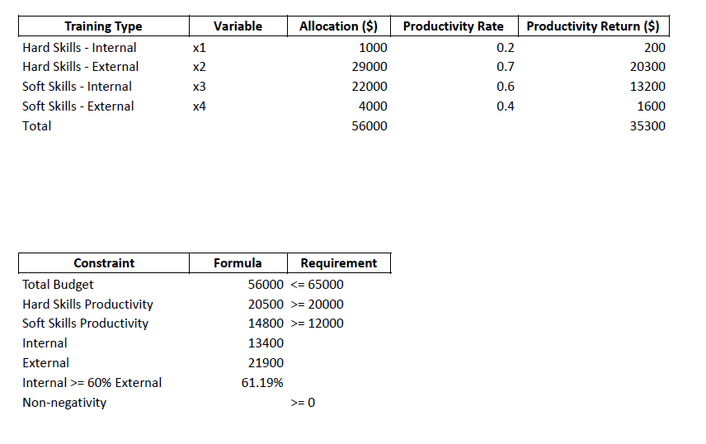
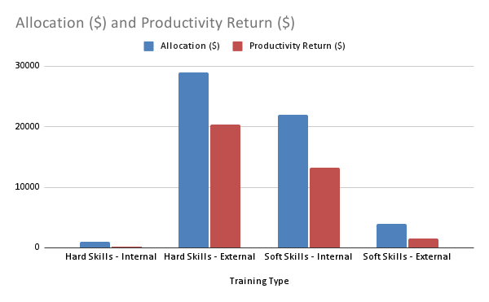
Effects Application Exercise 3 – Designing a Deterministic Optimization Model
Total Budget = 56,000 ≤ 65,000
Min. Hard Skills Productivity = 20,500 ≥ 20,000
Min. Soft Skills Productivity = 14,800 ≥ 20,000
Internal Productivity = 61.19%

Slide 13
Measurement Describe the anticipated effects of your strategy and how you will measure them
Measurement Techniques Used
A/B Testing: Test new ad formats, user experiences, and anti-adblock messages with experimental and control groups to identify causal effects.
Dashboard Reporting: Build real-time dashboards to visualize KPIs and track progress toward goals.
Regression Analysis: Analyze relationships between adblocker usage, user engagement, and revenue outcomes to confirm key drivers.
Causal Modeling: Use business model frameworks to validate that changes in user experience are driving the intended financial and operational results.
Flow:
User-centric Ad Innovation → Lower Adblocker Use → Higher Impressions → Increased Revenue

Slide 14
Measurement Application Exercise 4 – Identifying Key Drivers
Hypothesis:
If GYF implements more relevant, less intrusive ad formats and improves user experience (A), then adblocker usage will decrease (B), leading to increased ad impressions and advertising revenue (C).
Key Driver: Adblocker usage rate among GYF users
Measurement:
Percentage of active users using “adblockers” that will be measured via site analytics, surveys, and browser detection
Engagement rate with new ad formats which can be measured via click-through rate, viewability rate, opt-in rate
Advertising revenue per user segment
Linkage between 2-steps:
Collect data before and after implementing new ad formats: track changes in adblocker usage rate, engagement metrics, and revenue.
Use A/B testing: Compare user segments exposed to new vs. old ad formats.
Analyze correlations and trends: Test if a decrease in adblocker usage is followed by higher ad impressions and revenue.
Regularly review the data and, if the expected link is not observed, investigate barriers or revise the strategy.

Slide 15
Conclusion
Data-driven customer analytics will guide the development of less intrusive, more relevant ad formats to reduce adblocker usage and enhance user satisfaction.
Operational analytics will enable rapid experimentation, A/B testing, and continuous improvement, ensuring the strategy adapts quickly to user feedback and changing conditions.
Accounting analytics will focus on measuring financial and nonfinancial outcomes, including ad revenue, viewability, and engagement, to verify the effectiveness of the strategy.
People analytics will ensure the right talent and team structure are in place to implement and sustain these changes.
Optimization models were used to allocate resources efficiently, maximizing productivity and meeting organizational constraints.
Measurement plans include surveys, site analytics, A/B testing, dashboards, and regression analysis to track progress and verify causal linkages.
The integrated approach is expected to improve user experience, increase advertising revenue, and strengthen GYF’s organizational capabilities.

